Slide 1


Slide 2
CAPSTONE PROJECT: aNALYSIS for Product Demand
Presented by: Shruti Shikha Singh

Slide 3
About Dataset Context
The dataset contains historical product demand for a manufacturing company with footprints globally.
The company provides thousands of products within dozens of product categories.
There are four central warehouses to ship products within the region it is responsible for.
Since the products are manufactured in different locations all over the world, it normally takes more than one month to ship products via ocean to different central warehouses.
If forecasts for each product in different central with reasonable accuracy for the monthly demand for month after next can be achieved, it would be beneficial to the company in multiple ways.
Content
Historical Product Demand.csv - CSV data file containing product demand for encoded product id's
Acknowledgements
This dataset is all real-life data and products/warehouse and category information encoded.

Slide 4
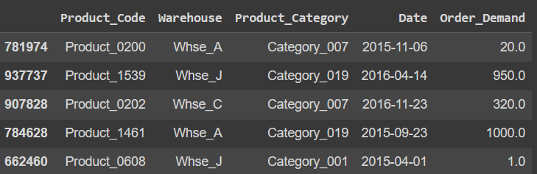
DATASET​

Slide 5
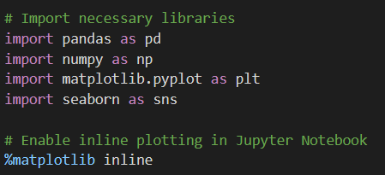
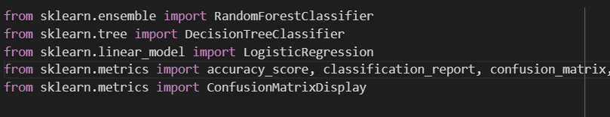
Importing libraries​

Slide 6
Univariate Analysis ​

Slide 7
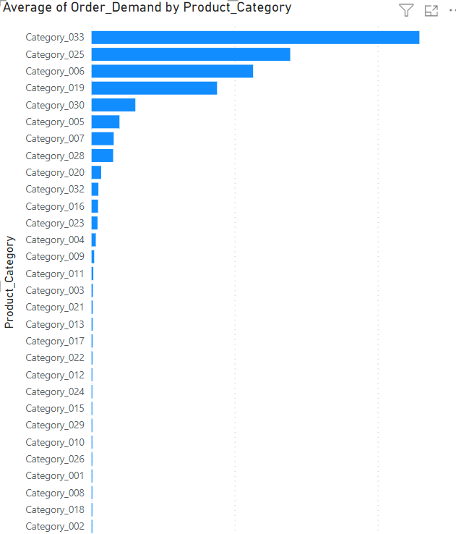
Observation 1:
This graph is the ranking of the average Order demanded by different warehouses.
This analysis clearly reveals that the product category 'Category_033' ranks as the highest Avg Order Demanded, outperforming all other categories in terms of demand.
We need to maintain the order demand of top 9 Categories.
We need to increase or work on rest of the categories as they are not performing well.

Slide 8
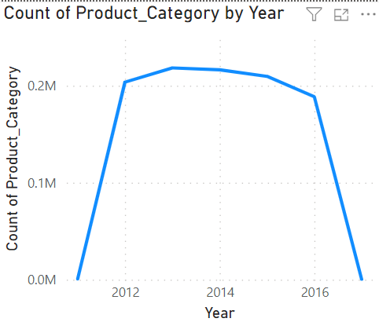
Observation 7:
The displayed graph provides insight into the yearly demand patterns of the all the Product Categories.
1. It shows that after increase in the product demand in the year 2011 the product demand is stable in the rest of the year.
2. And a huge decline in the year 2017.

Slide 9
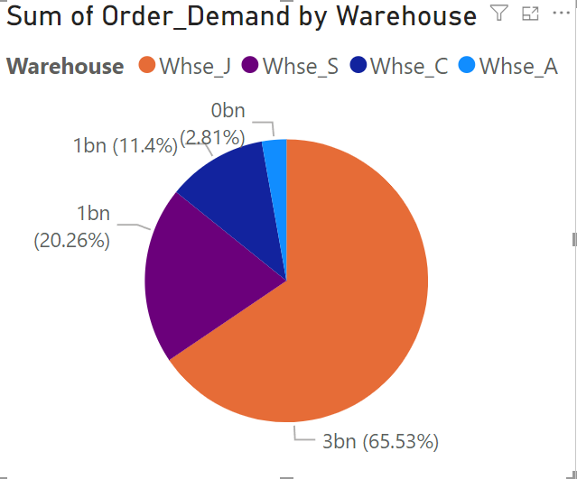
Observation 8:
Warehouse-J holds the distinction of having the highest maximum order demand, followed by Warehouse-S, Warehouse-C, and Warehouse-A, in descending order of their maximum demand levels.
We need to observe the Whse_A and see what is the reason this warehouse is not performing well.
And see what we can do to improve its performance.

Slide 10
Data Cleaning

Slide 11
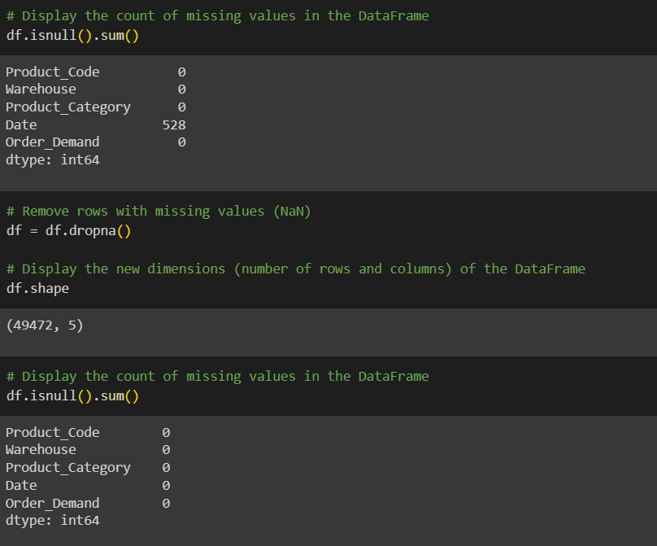
Removal of null values

Slide 12
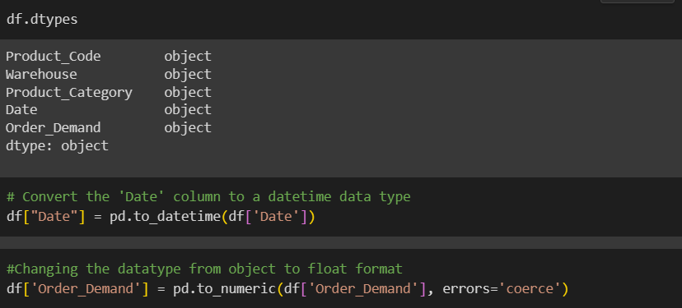
Change in data types

Slide 13
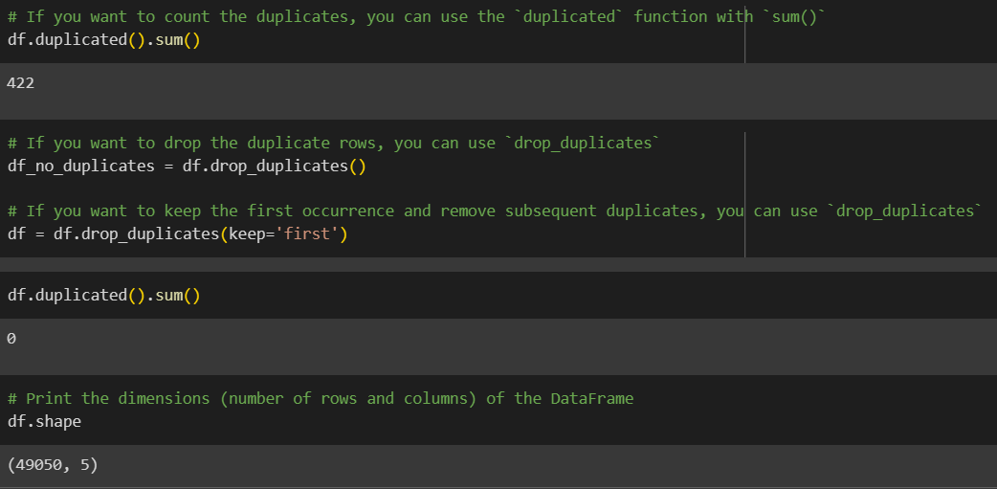
Removal of duplicates

Slide 14
Removal of duplicates

Slide 15
MODEL BUILDING

Slide 16
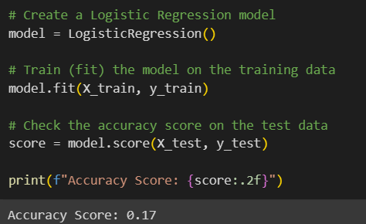
LOGISTIC REGRESSION

Slide 17
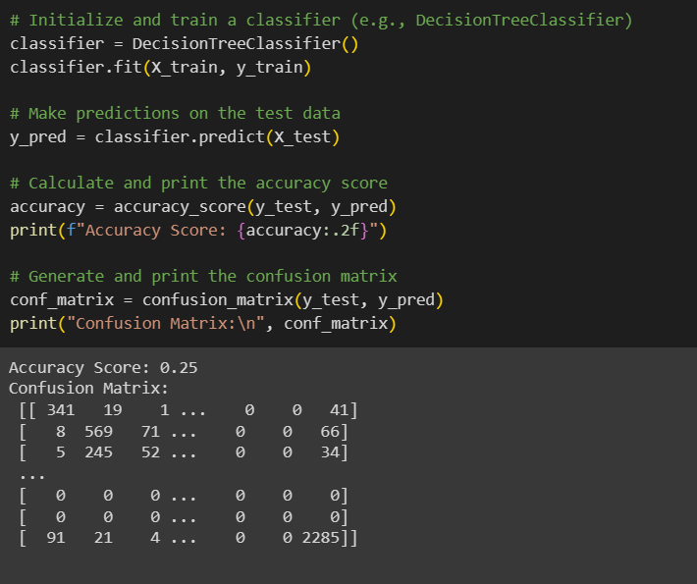
DECISION TREE

Slide 18
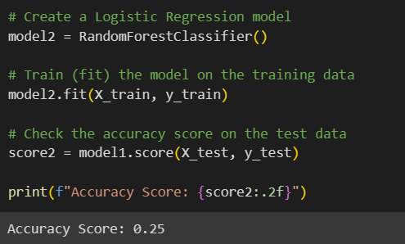
RANDOM FOREST

Slide 19
RESULTS & CONCLUSION​

Slide 20
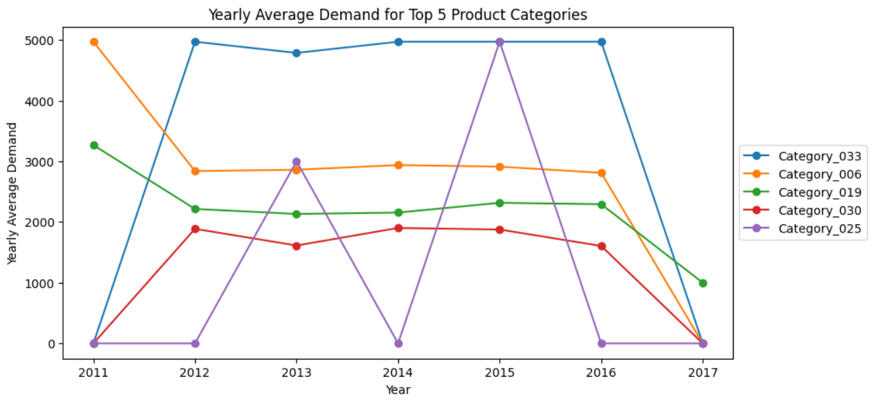
Observation 6:
The displayed graph provides insight into the yearly demand patterns of the top 5 Product Categories.
1. Category_025 exhibits a perplexing performance marked by fluctuations and unpredictable demand trends.
2. Category_033 stands out with the highest recorded performance, showcasing remarkable consistency in its demand over the years.

Slide 21
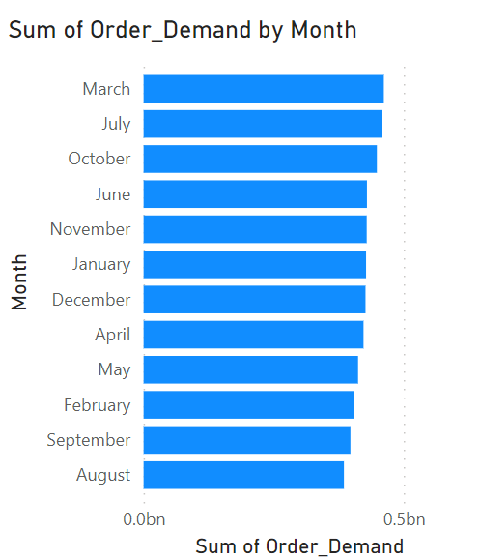
Observation 9:
The graph clearly illustrates that March experiences the highest demand for different Product Categories, while August records the lowest demand throughout the observed period.

Slide 22
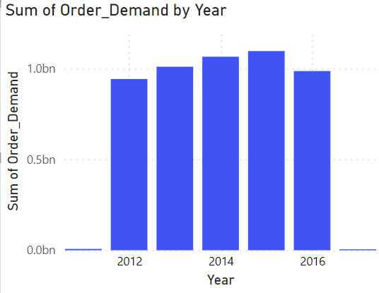
Observation 10:
It is evident from the data that the year 2015 stands out with the highest Order Demand compared to all other years, indicating a peak in demand during that particular year.

Slide 23
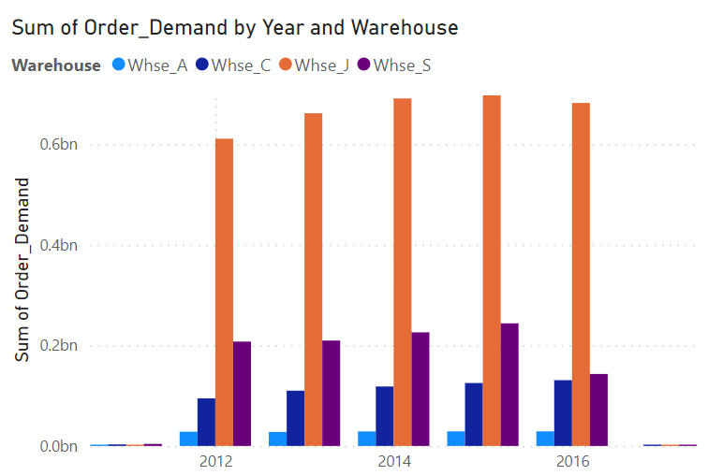
Observation 8:
Warehouse-J exhibits a significantly higher order demand in compared to other warehouses especially in 2015 it reaches its utmost capability till now same with the other warehouses.
Whereas Warehouse-A exhibits a significantly lower order demand in compared to other warehouses.

Slide 24
Thank You

